Slide 1
Information Theory Part I
Alex Alemi
2021-03-23
Part 1
Part 2
Part 3
Problem Set
Solutions

Slide 2
Information Theory is about communication

Slide 3
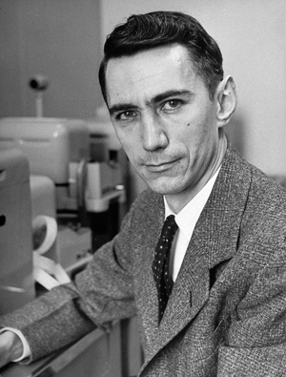
Claude Shannon
A The Mathematical Theory of Communication - 1948
Information theory primarily concerned with communication.
Have it to thank for basically all things digital.

Slide 4
'48 Shannon publishes A Mathematical Theory of Communication
'72 Discrete Cosine Transform developed
'51 Kullback-Leibler Divergence
'06 Asymmetric numeral systems zstandard
'89 zip
'62 Low density parity codes developed
'77 Lempel-Ziv
'94 Burrows-Wheeler bzip2
1870s Boltzmann's H-theorem and Gibbs entropy
'60 Reed-Solomon codes
'76 Arithmetic coding
'08 polar codes
'47 Hamming Codes
'93 Turbo codes
'67 Viterbi algorithm
'51 Huffman encoding
Timeline of Information Theory

Slide 5
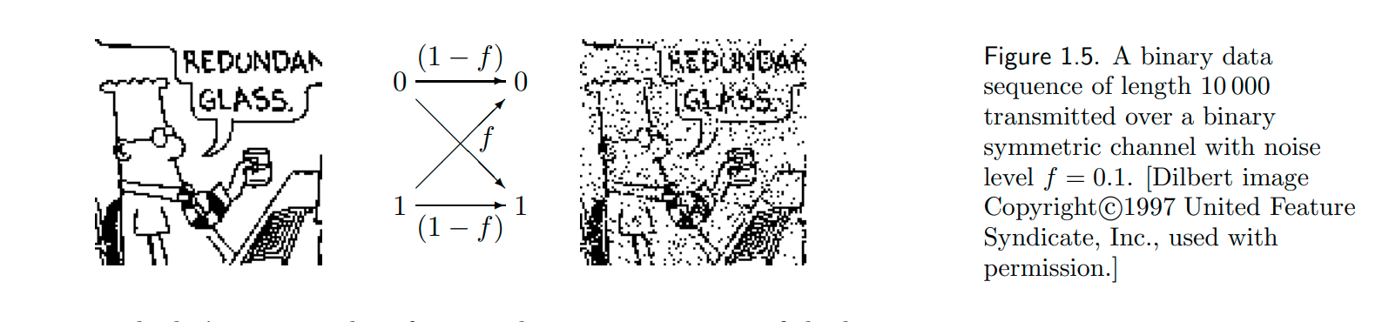
From MacKay's Information Theory, Inference and Learning Algorithms
Noisy Channels

Slide 6
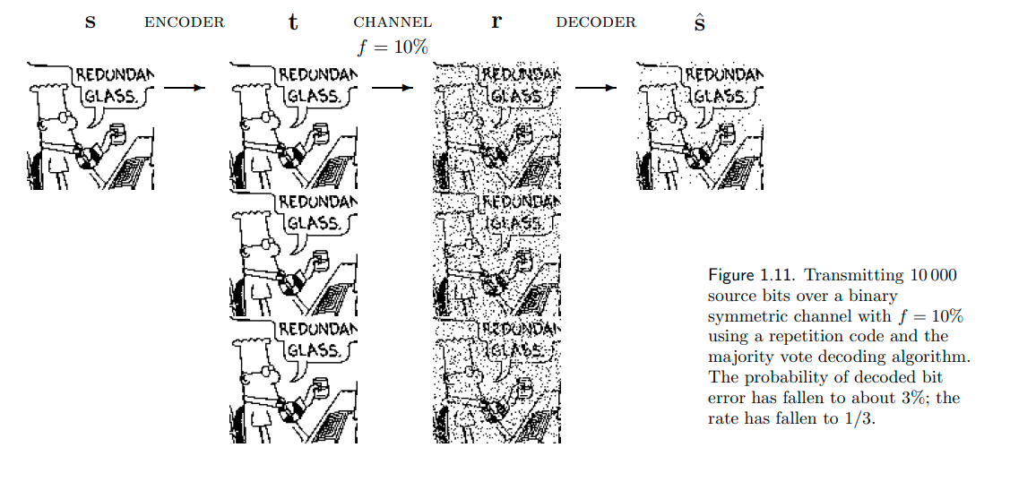
From MacKay's Information Theory, Inference and Learning Algorithms
Repetition Codes

Slide 7
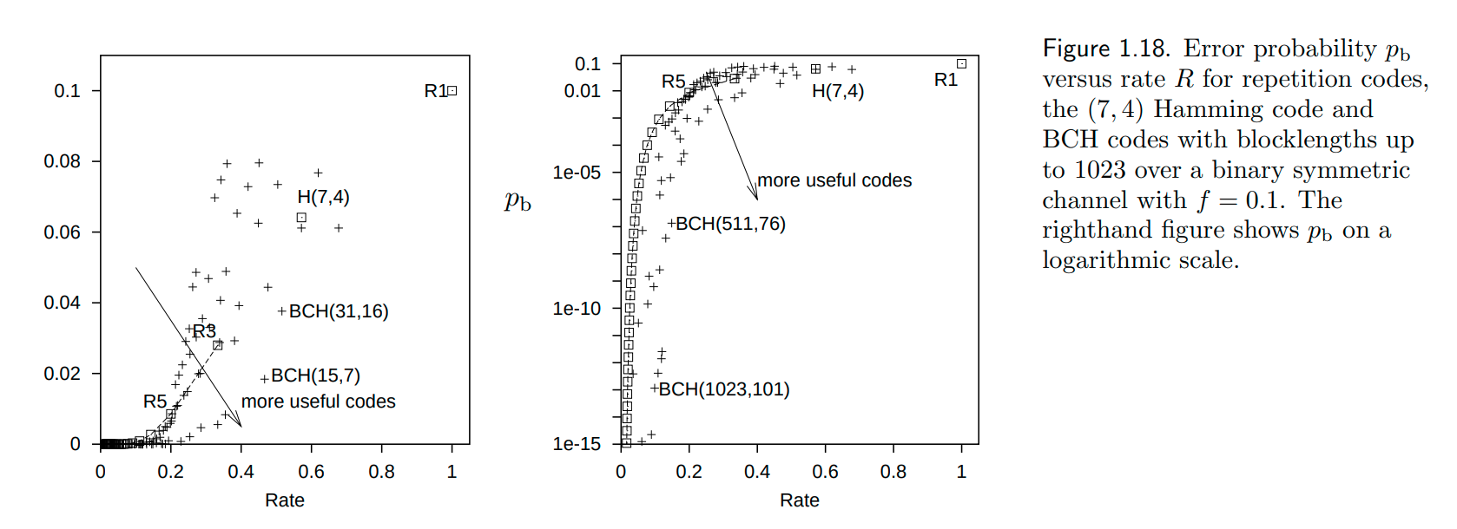
From MacKay's Information Theory, Inference and Learning Algorithms
Repetition Codes

Slide 8
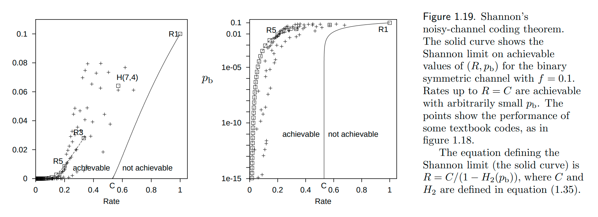
The Noisy Channel Coding Theorem
From MacKay's Information Theory, Inference and Learning Algorithms

Slide 9

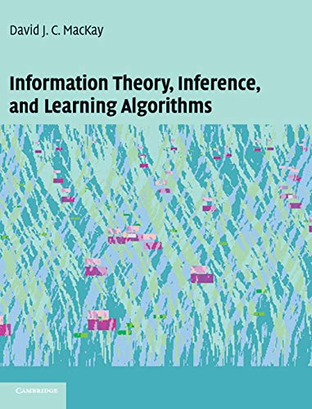

Where to get Help

Slide 10
Information Theory is about measurements

Slide 11
Cast of Characters
weight of evidence
relative entropy
entropy
mutual information
measures the importance of data for distinguishing hypotheses
measures a "distance" between two distributions
measures a "complexity" of a distribution
measures the "complexity" of the interaction between two random variables.

Slide 12




Cast of Characters
weight of evidence
relative entropy
entropy
mutual information

Slide 13
Weight of Evidence

Slide 14
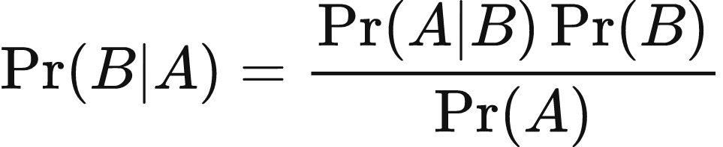
Bayes Rule
Bayes Rule = Joint probability sliced two ways + algebra.

Slide 15
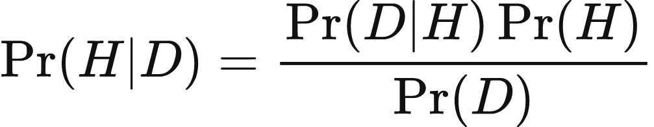
Bayes Rule
What if H is hypothesis, D is data?

Slide 16
Bayes Rule
The probability of the data given the hypothesis
The probability of the hypothesis
The probability a hypothesis is true given the data
The probability of the data

Slide 17
Bayes Rule
Likelihood
Prior Probability
Posterior Probability
Marginal Likelihood

Slide 18
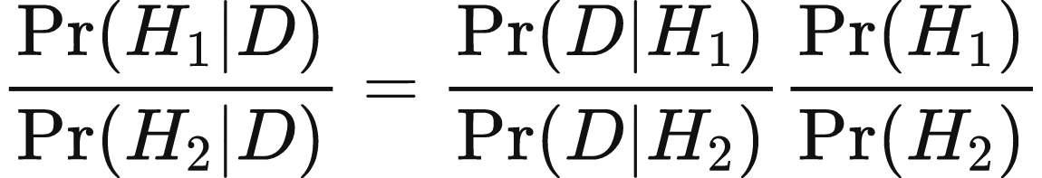
Bayes Factor
Posterior Odds
Bayes Factor
Prior Odds

Slide 19
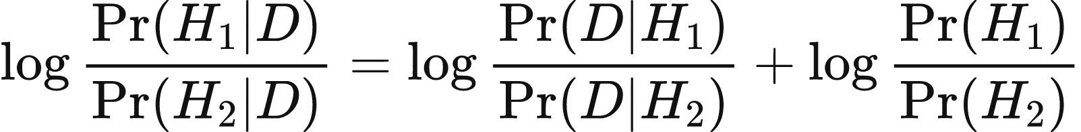
Bayes Factor
Posterior Log Odds
Weight of Evidence
Prior Log Odds
Posterior log odds are prior log odds + weight of evidence

Slide 20
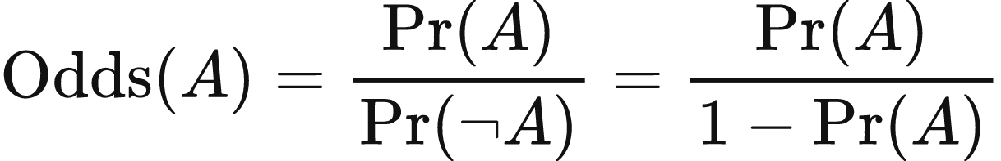
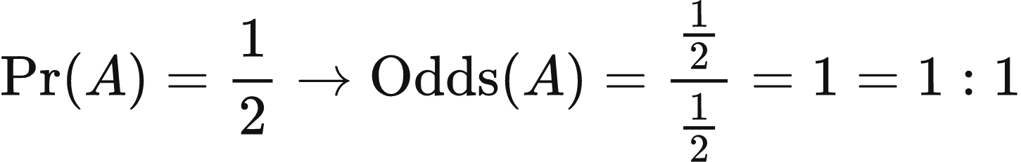
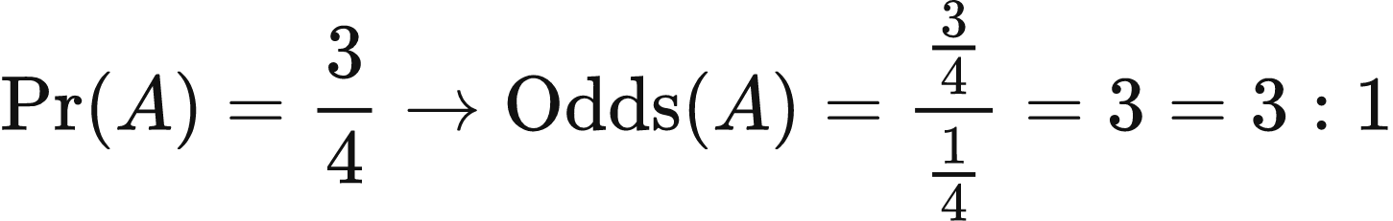
Odds

Slide 21
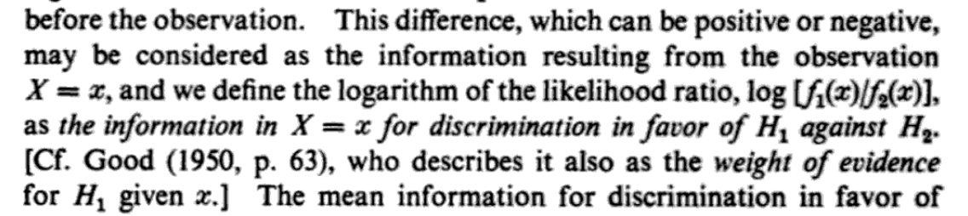
"Information"
Posterior Log Odds
Weight of Evidence
Prior Log Odds

Slide 22


Hypotheses
The probability that some random variable X takes on a value x given that some model is true

Slide 23
Probability Densities
The probability that some continuous random variable X takes on a value between x and x + dx given that some model is true

Slide 24
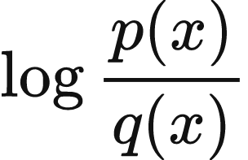
Weight of Evidence

Slide 25
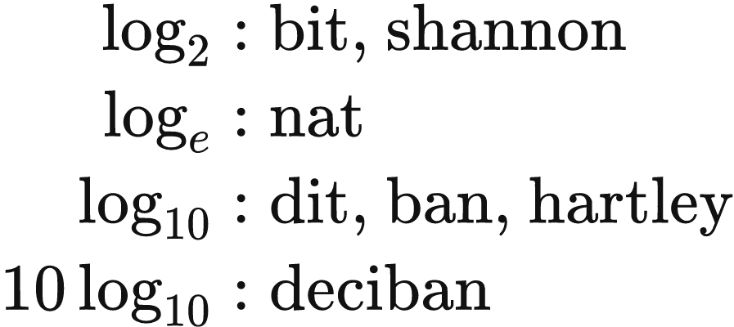


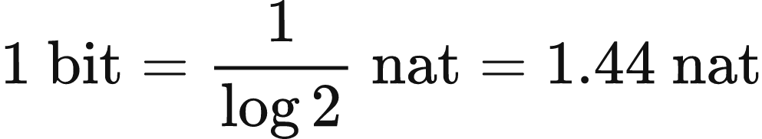
Units

Slide 26
Decibans
db | 0 | 1 | 2 | 3 | 4 | 5 | 6 | 7 | 8 | 9 | 10 | 11 | 12 | 13
bit | 0 | ⅓ | ⅔ | 1 | 1 ⅓ | 1 ⅔ | 2 | 2 ⅓ | 2 ⅔ | 3 | 3 ⅓ | 3 ⅔ | 4 | 4 ⅓
nat | 0.00 | 0.23 | 0.46 | 0.69 | 0.92 | 1.15 | 1.38 | 1.61 | 1.84 | 2.07 | 2.30 | 2.53 | 2.76 | 2.99
odds | 1:1 | 5:4 | 𝛑:2 | 2:1 | 5:2 | 𝛑:1 | 4:1 | 5:1 | 2𝛑:1 | 8:1 | 10:1 | 4𝛑:1 | 16:1 | 20:1
p | 50% | 56% | 61% | 67% | 72% | 76% | 80% | 83% | 86% | 89% | 91% | 93% | 94% | 95%

Slide 27
Belief-O-Meter
-12
-10
-8
-6
-4
-2
0
+2
+4
+6
+8
+10
+12
1:20
1:10
1:5
1:2
1:1
2:1
5:1
10:1
20:1

Slide 28
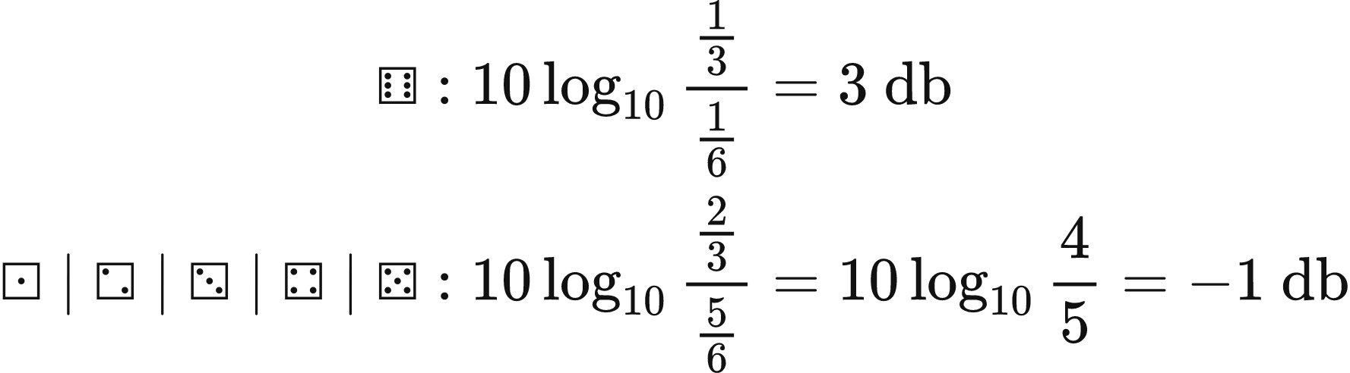
Examples: Loaded Dice
Hypothesis 1: Die is loaded and shows ⚅ 1/3 of the time.
Hypothesis 2: Die is fair.

Slide 29
Multiple Observations
Independent observations decompose additively given the logarithmic form.

Slide 30
Example: Loaded Dice
⚅ ⚅ ⚄ ⚅ ⚅ ⚄ ⚅ ⚅ ⚃ ⚀ ⚅ ⚅ ⚅ ⚁ ⚃ ⚃ ⚀ ⚃ ⚅ ⚁
10 ⚅ and 10 non-⚅.
3 db for each ⚅, -1 for each non-⚅ ,
we end up with 20 db in favor.

Slide 31
Belief-O-Meter
-12
-10
-8
-6
-4
-2
0
+2
+4
+6
+8
+10
+12
1:20
1:10
1:5
1:2
1:1
2:1
5:1
10:1
20:1

Slide 32
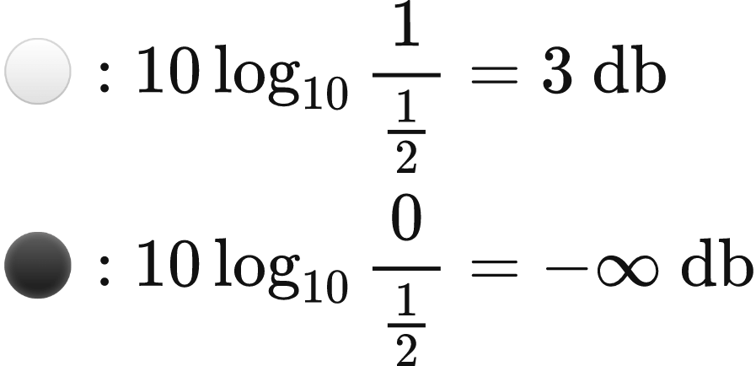
Examples: Coin
Hypothesis 1: Coin is doubled headed. ⚪/⚪
Hypothesis 2: Coin is fair. ⚪/⚫

Slide 33
Examples: Births
Hypothesis 1: Human births are 51% male ♂- 49% female♀
Hypothesis 2: Human births are 50% male♂- 50% female♀
Laplace looked at Parisian birth records and found that between 1745 and 1770, 251,527 males and 241,945 females were born.

Slide 34
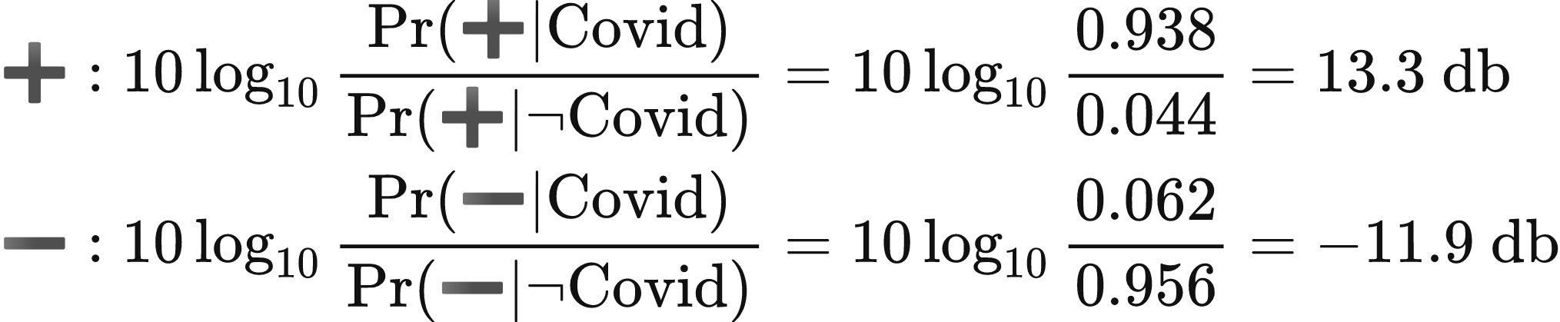
Examples: Covid
Hypothesis 1: You have Covid.
Hypothesis 2: You don't have Covid.

Slide 35
Combine with Prior
Posterior Log Odds
Weight of Evidence
Prior Log Odds
-12
-10
-8
-6
-4
-2
0
+2
+4
+6
+8
+10
+12
1:20
1:10
1:5
1:2
1:1
2:1
5:1
10:1
20:1

Slide 36
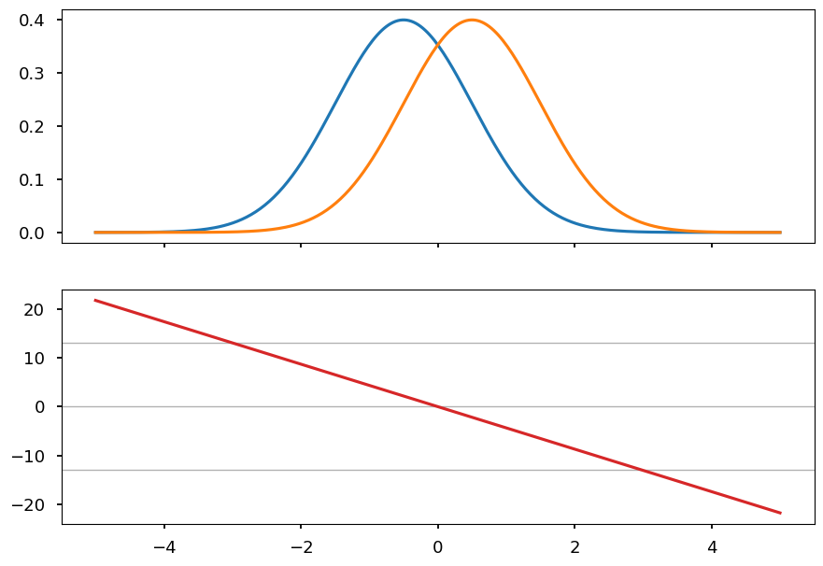
Examples: Gaussians

Slide 37
Examples: M&Ms
Hypothesis 1: M&M Bag is from NJ.
Hypothesis 2: M&M Bag is from TN.
 | ⬤ | ⬤ | ⬤ | ⬤ | ⬤ | ⬤
Hackettstown, NJ | 12.5% | 12.5% | 12.5% | 12.5% | 25% | 25%
Cleveland, TN | 12.4% | 13.1% | 13.5% | 19.8% | 20.5% | 20.7%
db | 0.035 | -0.20 | -0.33 | -2.0 | 0.86 | 0.82

Slide 38
Should we expect to be able to tell where our M&M bag came from?

Slide 39
Relative Entropy (KL Divergence)

Slide 40
Relative Entropy is expected weight of evidence.

Slide 41
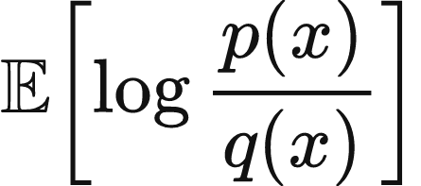
Expected Weight of Evidence
But expected with respect to what?

Slide 42
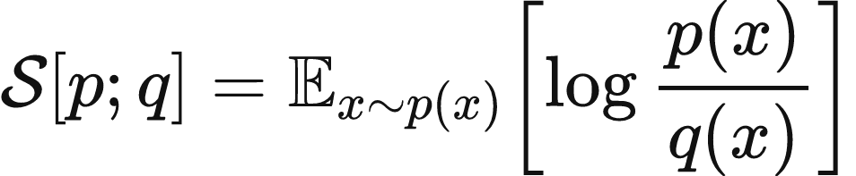
Relative Entropy

Slide 43
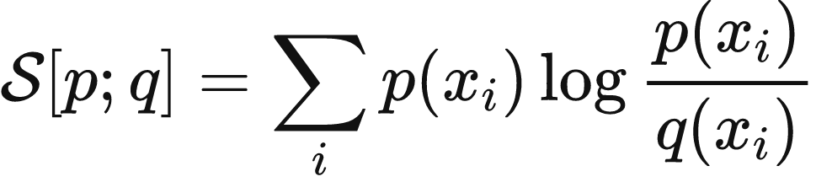
Relative Entropy

Slide 44
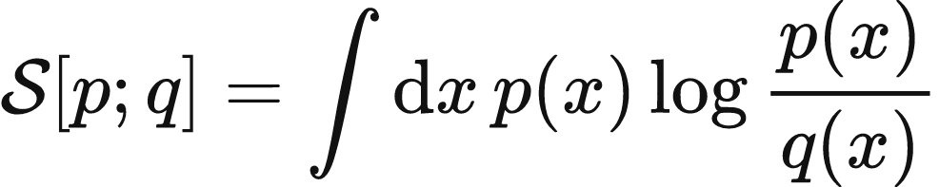
Relative Entropy

Slide 45
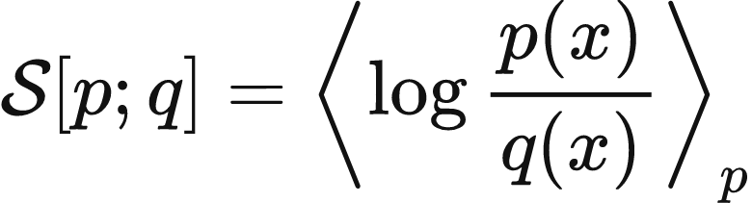
Relative Entropy

Slide 46




Examples: M&Ms
 | ⬤ | ⬤ | ⬤ | ⬤ | ⬤ | ⬤
Hackettstown, NJ | 12.5% | 12.5% | 12.5% | 12.5% | 25% | 25%
Cleveland, TN | 12.4% | 13.1% | 13.5% | 19.8% | 20.5% | 20.7%
db | 0.035 | -0.20 | -0.33 | -2.0 | 0.86 | 0.82

Slide 47
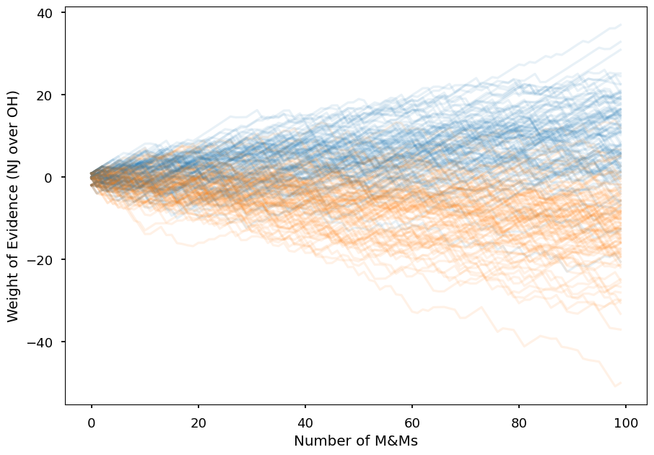
Examples: M&Ms

Slide 48
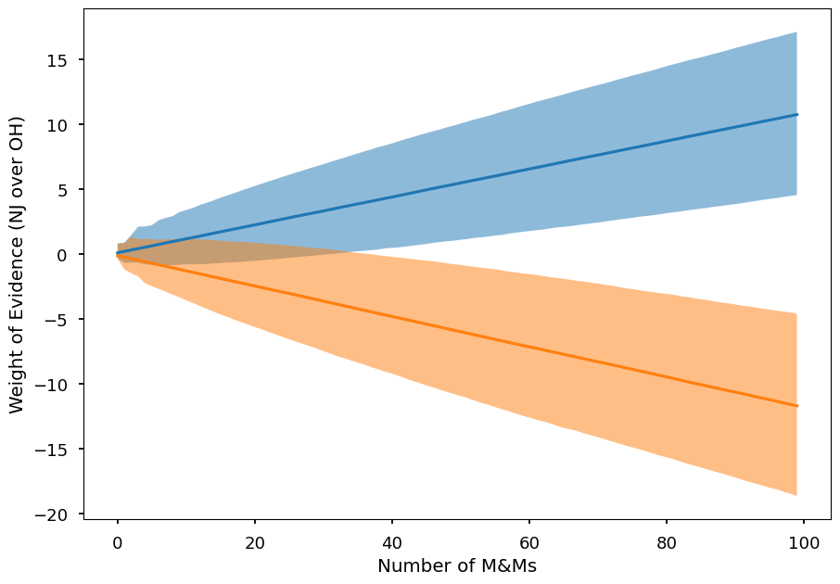
Examples: M&Ms

Slide 49
Relative Entropy is asymmetric in its arguments.

Slide 50
Updating Beliefs
Imagine the COVID example again, let's say you started with some belief distribution over outcomes (blue distribution) and then updated to
some new beliefs (orange distribution).
How much did your beliefs change?
DT
DT
6.6%
61.6%
0.4%
DT̅
0%
DT̅
4.1%
38.4%
D̅T
D̅T
88.9%
0%
D̅T̅
D̅T̅

Slide 51
Break
Q: How would you measure the magnitude of your updated beliefs? What properties does that magnitude have?

Slide 52
Relative Entropy is a measure of the magnitude in your updated beliefs

Slide 53





Continuous
 | ⬤ | ⬤ | ⬤ | ⬤ | ⬤ | ⬤
Hackettstown, NJ | 12.5% | 12.5% | 12.5% | 12.5% | 25% 24% | 25% 26%
Cleveland, TN | 12.4% | 13.1% | 13.5% | 19.8% | 20.5% | 20.7%
db | 0.035 | -0.20 | -0.33 | -2.0 | 0.86 | 0.82

Slide 54
Relative Entropy is reparameterization independent

Slide 55



Permutation Invariant
 | ⬤ | ⬤ | ⬤ | ⬤ | ⬤ | ⬤
Hackettstown, NJ | 12.5% | 25% | 12.5% | 12.5% | 12.5% | 25%
Cleveland, TN | 19.8% | 20.7% | 12.4% | 13.5% | 13.1% | 20.5%
db | -2.0 | 0.82 | 0.035 | -0.33 | -0.20 | 0.86

Slide 56
Reparameterization Invariant
Our belief update magnitude should be invariant to change of coordinates.

Slide 57
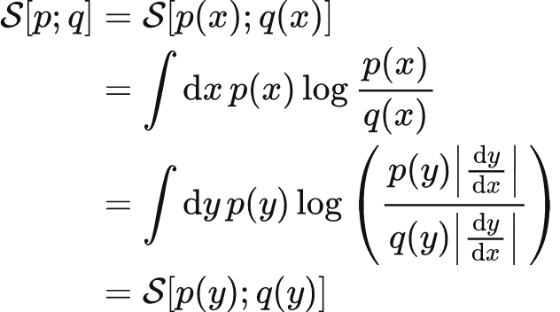

Reparameterization Invariant
Consider a remapping of our coordinate system. The Relative Entropy is invariant to such a mapping.

Slide 58
Relative Entropy is non-negative

Slide 59

Non-Negative
Very useful property!
Intuitively, viewing Relative Entropy as expected weight of evidence, this is saying that the expected weight of evidence in favor of the truth is always positive.
More data is always a good thing when we are trying to learn the truth.

Slide 60
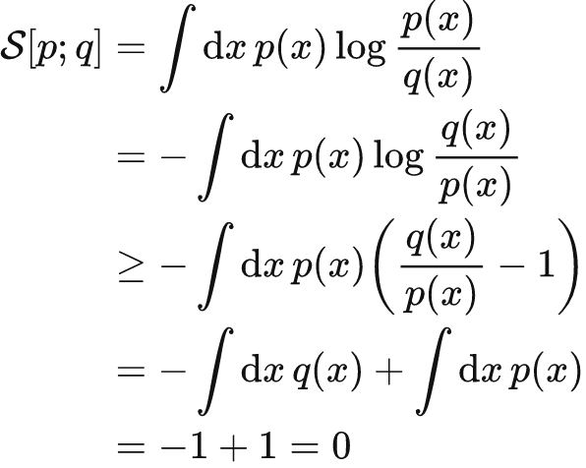
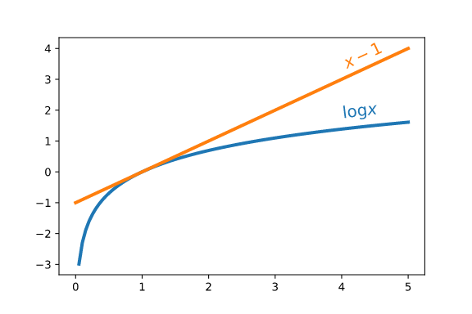


Non-Negative
Relative Entropy is always non-negative!

Slide 61
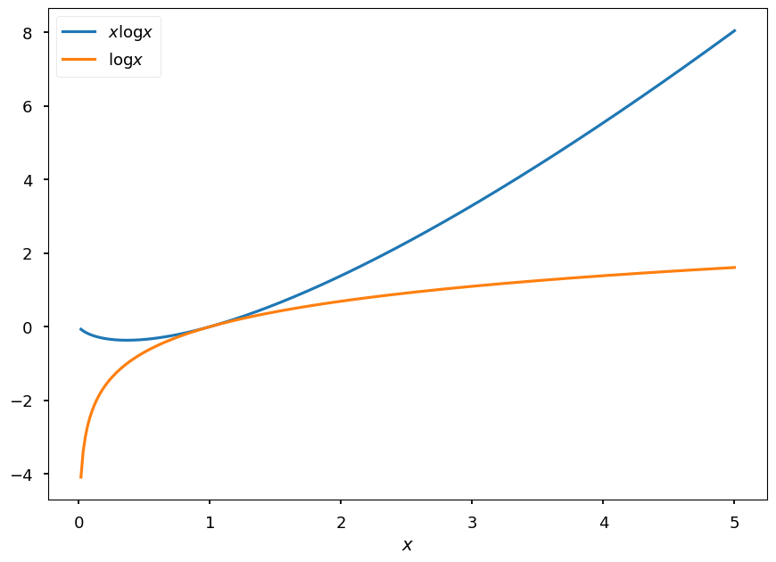
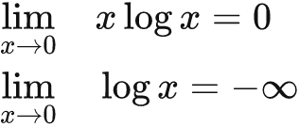
Edges
p can be zero where q is not zero, and this doesn't count towards the KL.
q cannot be zero where p is not zero.

Slide 62
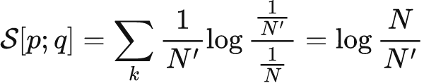
Monotonic
Consider updating our beliefs from a uniform distribution on N elements to one on N' < N elements.
Cutting a space in half is 1 bit of KL.
In general Relative Entropy is the number of optimal yes-no questions needed to move from q to p.

Slide 63
Chain Rule
We could decompose a situation into multiple steps. Want our measurement of information gain to be the same in either.
100%
T
93.8%
T
DT
DT
D
D
61.6%
6.6%
T̅
61.6%
0%
7%
T̅
DT̅
DT̅
6.2%
0%
0.4%
38.4%
4.1%
100%
T
D̅T
D̅T
38.3%
4.4%
T
D̅
93%
0%
88.9%
D̅
D̅T̅
D̅T̅
0%
T̅
95.6%
T̅

Slide 64

Chain Rule
100%
T
93.8%
T
D
D
61.6%
0%
T̅
7%
6.2%
T̅
100%
T
38.3%
4.4%
T
D̅
93%
D̅
0%
T̅
95.6%
T̅

Slide 65

Bayes Rules
Bayes Rule corresponds to a minimal update!
61.6%
D
D
61.6%
DT
DT
T
T
6.6%
61.6%
10.7%
38.4%
D̅
100%
D̅
DT̅
DT̅
38.4%
0.4%
0%
4.1%
38.4%
D
D
D̅T
D̅T
89.3%
4.1%
0%
4.1%
88.9%
0%
T̅
T̅
D̅T̅
D̅T̅
D̅
D̅
95.9%
95.9%

Slide 66
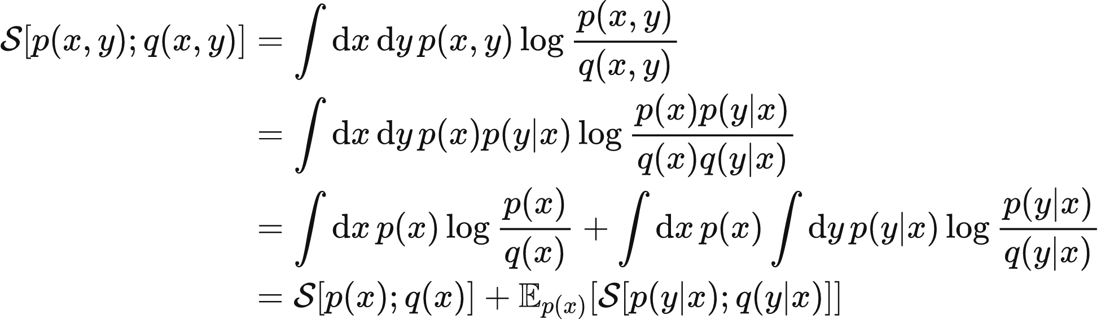
Chain Rule

Slide 67
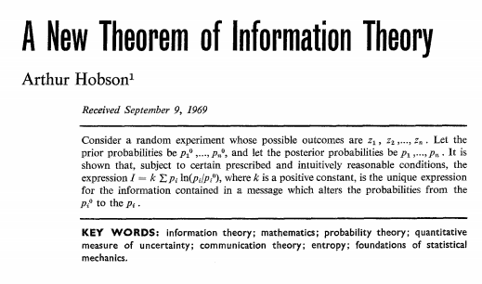
Hobson

Slide 68
Hobson
Relative Entropy is unique given some reasonable axiomatic requirements.
We want our measure of information gain to be:
Continuous. Small changes in the distributions should correspond to small changes in the information gain.
Reparameterization Independent. Changing our coordinate system shouldn't have an effect on our measurement.
Non-negative. Should always be positive.
Monotonic. In a natural way, restricting to fewer and fewer things should be a larger and larger change.
Satisfy a natural additive chain rule. If we decompose our probability into steps, we should get the same answer.
The Relative Entropy is the only function to satisfy all of these requirements.

Slide 69
Relative Entropy is the Kullback-Leibler Divergence, a "distance" between distributions

Slide 70


Number of Samples to Distinguish
Relative Entropy is like a "distance" between distributions.
As the expected weight of evidence, it's how easy it would be to distinguish p from q if p were true.
Births:

Slide 71

KL Divergence is asymmetric
https://twitter.com/ari_seff/status/1303741288911638530

Slide 72


A Principle For Learning
Make it hard to tell the difference between the real world and your model.
-Data Entropy
Cross Entropy

Slide 73
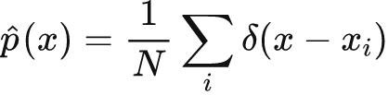

Maximum Likelihood
We don't have access to the true distribution of data, only samples.
Empirical Cross Entropy

Slide 74
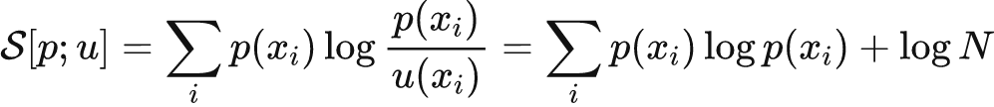


Relative Entropy to a Uniform Distribution
The uniform distribution is special, the Relative entropy with respect to the uniform distribution is special.
Entropy is a measure of how un-uniform a distribution is.
How easy it is is to distinguish it from a uniform distribution.

Slide 75
Mutual Information
Mutual information is the relative entropy between a joint distribution and the product of its marginals.
It tests how easily we can discern whether there is a relationship between the two variables, rather than them being independent.

Slide 76
Summary
weight of evidence
relative entropy
entropy
mutual information

Slide 77
FIN
(THE END)
Please check out the Problem Set here
Solutions here

Slide 78
Information Theory Part II
Alex Alemi
2021-03-30
Part 1
Part 2
Part 3
Problem Set
Solutions

Slide 79
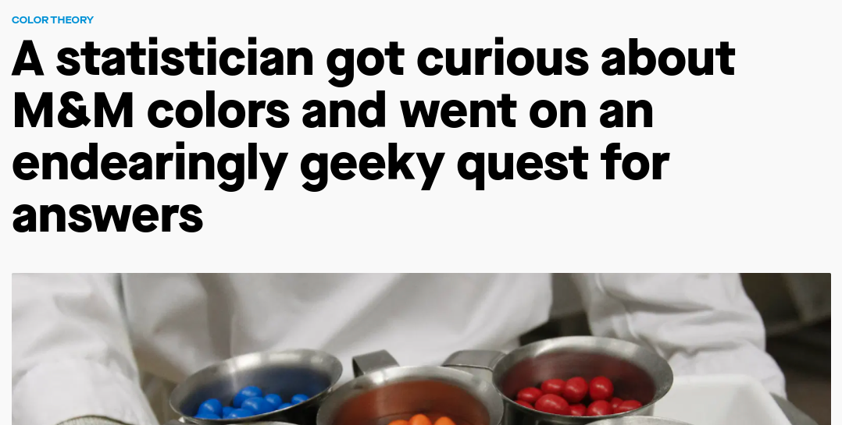

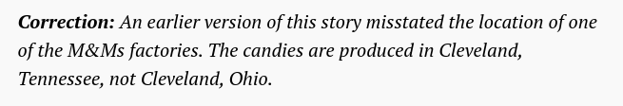
Errata
Cleveland, TN not Cleveland, OH
[quartz article]
[SAS article]

Slide 80
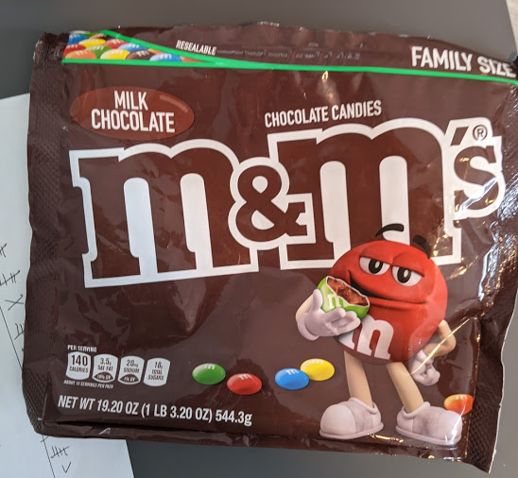
Analysis

Slide 81

M&M Analysis
Hypothesis 1: M&M Bag is from NJ.
Hypothesis 2: M&M Bag is from TN.
 | ⬤ | ⬤ | ⬤ | ⬤ | ⬤ | ⬤
Hackettstown, NJ | 12.5% | 12.5% | 12.5% | 12.5% | 25% | 25%
Cleveland, TN | 12.4% | 13.1% | 13.5% | 19.8% | 20.5% | 20.7%
db | 0.035 | -0.20 | -0.33 | -2.0 | 0.86 | 0.82
My Bag | 87 | 69 | 93 | 124 | 136 | 96

Slide 82
M&M Analysis
Hypothesis 1: M&M Bag is from NJ.
Hypothesis 2: M&M Bag is from TN.
 | ⬤ | ⬤ | ⬤ | ⬤ | ⬤ | ⬤
Hackettstown, NJ | 12.5% | 12.5% | 12.5% | 12.5% | 25% | 25%
Cleveland, TN | 12.4% | 13.1% | 13.5% | 19.8% | 20.5% | 20.7%
db | 0.035 | -0.20 | -0.33 | -2.0 | 0.86 | 0.82
My Bag | 14.4% | 11.4% | 15.4% | 20.5% | 22.5% | 15.8%

Slide 83
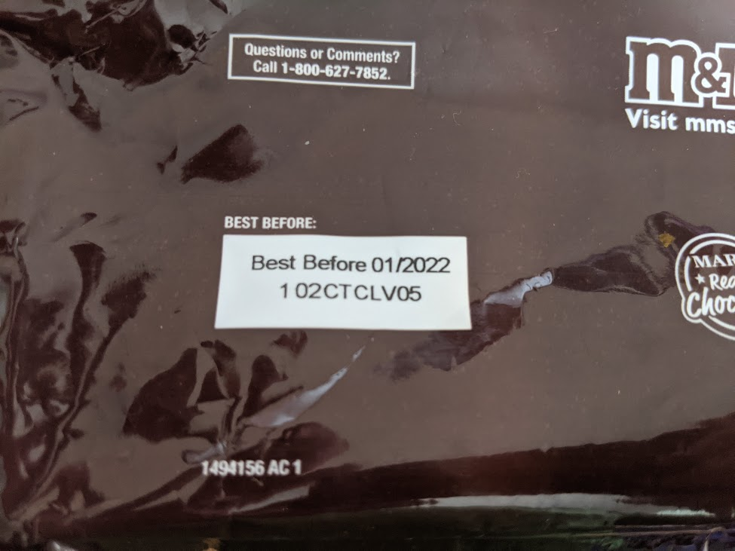
Smoking Gun

Slide 84
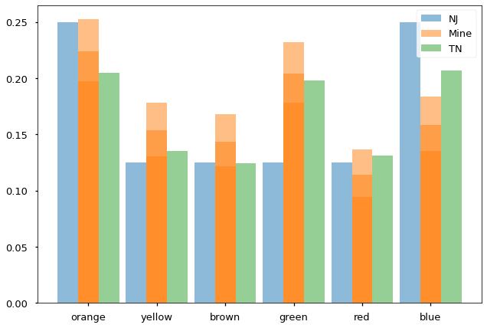
M&M Analysis
Deviation as large as the one observed from NJ happened 0 out of a million trials,
For TN it was 1 out of 48, ~2%

Slide 85

Unhelpful

Slide 86
Two Ends
-12
-10
-8
-6
-4
-2
0
+2
+4
+6
+8
+10
+12
1:20
1:10
1:5
1:2
1:1
2:1
5:1
10:1
20:1
Your Bag of M&Ms came from NJ
Your Bag of M&Ms came from TN

Slide 87
Two Ends
-12
-10
-8
-6
-4
-2
0
+2
+4
+6
+8
+10
+12
1:20
1:10
1:5
1:2
1:1
2:1
5:1
10:1
20:1
It'll rain tomorrow
It'll snow tomorrow

Slide 88
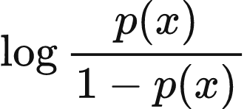
Two Ends
-12
-10
-8
-6
-4
-2
0
+2
+4
+6
+8
+10
+12
1:20
1:10
1:5
1:2
1:1
2:1
5:1
10:1
20:1
You win the lottery
You don't win the lottery

Slide 89
Recap
weight of evidence
relative entropy
expected weight of evidence | magnitude of belief update

Slide 90
Multiple Hypotheses

Slide 91

Exhaustive Set
Hypothesis 1: The dice landed ⚀
Hypothesis 2: The dice landed ⚀|⚁|⚂|⚃|⚄|⚅
Posterior Log Odds
Weight of Evidence
Prior Log Odds

Slide 92
Exhaustive Set
Hypothesis 1: The dice landed ⚀
Hypothesis 2: The dice landed ⚀|⚁|⚂|⚃|⚄|⚅
Posterior Log Odds
Weight of Evidence
Prior Log Odds

Slide 93
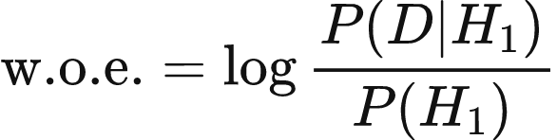

Information in Data for outcome
Hypothesis 1: The dice landed ⚀
Hypothesis 2: The dice landed ⚀|⚁|⚂|⚃|⚄|⚅
Data: the dice is showing ⚀

Slide 94
Information in Data for outcome
Hypothesis 1: The dice landed ⚀
Hypothesis 2: The dice landed ⚀|⚁|⚂|⚃|⚄|⚅
Data: the dice is showing ⚀

Slide 95
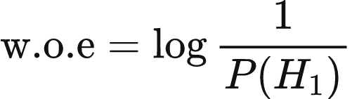
Information in Discerning Data
Hypothesis 1: The dice landed ⚀
Hypothesis 2: The dice landed ⚀|⚁|⚂|⚃|⚄|⚅
Information in the discerning observation of a hypothesis amongst a set of exhaustive alternatives

Slide 96


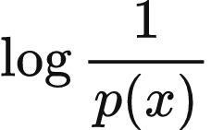
Observations of a Random Variable
Hypothesis 1:
Hypothesis 2:
Information in the observation of a particular value of a random variable.

Slide 97

"Surprise"
Small probability -> Large Surprise
Large Probability -> Small Surprise

Slide 98
"Surprise"
Small probability -> Large Surprise
Large Probability -> Small Surprise

Slide 99
Entropy

Slide 100
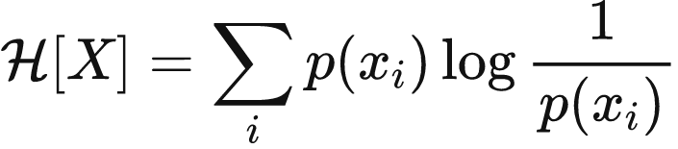
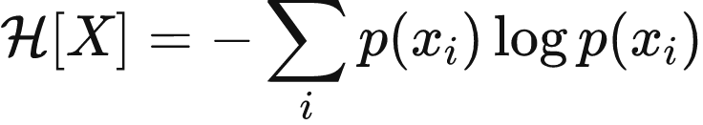
Entropy is Expected "Surprise"
Entropy is the expected "information content" of an observation of a random variable.

Slide 101
Shannon's Axioms of Entropy
Entropy is the unique measure of "surprise" satisfying some simple axioms. (from Shannon)
Continuous. Small changes in the probabilities should correspond to small changes in the entropy.
Monotonic. For uniform distributions, entropy should be an increasing function of N.
Satisfy a natural chain rule. If a choice is decomposed into a series of choices, the entropy would be the weighted sum of the pieces.
The Entropy is the only function to satisfy all of these requirements.

Slide 102
Relative Entropy to a Uniform Distribution
The uniform distribution is special, the Relative entropy with respect to the uniform distribution is special.
Entropy is a measure of how un-uniform a distribution is.
How easy it is is to distinguish it from a uniform distribution.

Slide 103

Entropy and Cross Entropy
Relative Entropy is Cross Entropy minus Entropy

Slide 104
Entropy is a measure of ignorance

Slide 105

Entropy of a Biased Coin
For a biased coin, entropy is maximal when the coin is fair, and is 1 bit for a single coin.

Slide 106



Example: Uniform Distributions
Number of yes-no questions to identify an element.
20 questions => 1 in a million

Slide 107
Entropy is the Data Compression Limit
In order to represent a sample from a discrete distribution, the entropy tells how many bits it takes to represent a sample from the distribution, on average.

Slide 108

Example: Cards
diamonds
clubs
diamonds
diamonds
spades
spades
hearts
clubs
diamonds
clubs
...

Slide 109

Example: Cards
♢
♣
♢
♢
♠
♠
♡
♣
♢
♣
...

Slide 110

Example: Cards
d
c
d
d
s
s
h
c
d
c
...

Slide 111


Example: Cards
11
00
11
11
01
01
10
00
11
00
...
0
1
This is the best we can do.
0
1
0
1
♣
♠
♡
♢

Slide 112

Example: Biased Cards
11
00
11
11
01
01
10
00
11
00
...
♣
♠
♡
♢
1/2
1/4
1/8
1/8

Slide 113

Example: Biased Cards
0
1
111
0
111
111
10
10
110
0
111
...
♣
0
1
0
♠
10
0
1
♡
♢
110
111

Slide 114
Example: Biased Cards
0
1
1110111111101011001110
♣
0
1
0
♠
10
0
1
♡
♢
110
111

Slide 115
Sampling Biased Cards
0
1
1110111111101011001110
♣
0
1
0
♠
10
0
1
♡
♢
110
111

Slide 116
Entropy is the Number of Coin Flips to Sample
In order to generate a sample from a discrete distribution, on average it takes as many fair coin flips as the entropy of the distribution.
0
1
♣
0
1
0
♠
10
0
1
♡
♢
110
111

Slide 117

Relative Entropy is Excess Cost
Relative entropy is how much more expensive it is to represent a sample from p if you use q to encode rather than p.

Slide 118
Asymptotic Equipartition Theorem

Slide 119

Weak Law of Large Numbers
Averages tend to means

Slide 120

Weak Law of Large Numbers
Joint likelihoods tend to entropies.

Slide 121
Typical Sets
Sequences with likelihoods ~ entropy

Slide 122


Asymptotic Equipartition Property
The typical set has probability near 1
Elements of the typical set are nearly equiprobable
The number of elements in the typical set is nearly

Slide 123


Biased Coin
Coin with p=0.11
300 flips

Slide 124

Sketch
Separate all possible sequences into two groups, typical and atypical. Prepend 0 if typical, 1 if atypical.
Index each of the typical examples
Index each of the atypical examples.

Slide 125
Entropy is ~ how many things there are

Slide 126
Continuous entropy is silly.

Slide 127





Continuous Entropy
?

Slide 128


Continuous Entropy

Slide 129



Cautionary Tale: Images

Slide 130
Mutual Information

Slide 131



Front and Top of Die
⚀ ⚁ ⚂ ⚃ ⚄ ⚅
If I tell you the front face of a die, how much does that reveal about the top?
⚀ ⚁ ⚂ ⚃ ⚄ ⚅

Slide 132
Mutual Information is a reduction in Entropy
Bits you learn about X after observing Y
Bits you need to represent an X sample
Bits you need to represent an X sample, if you know Y

Slide 133
Mutual Information
Mutual information is the relative entropy between a joint distribution and the product of its marginals.
It tests how easily we can discern whether there is a relationship between the two variables, rather than them being independent.

Slide 134

Mutual Information
Mutual Information is symmetric. It's also the relative entropy between the conditional distribution after observing a sample and the marginal.

Slide 135
Mutual Information is Positive
Mutual information is positive because relative entropy is positive.

Slide 136

Venn Diagrams
H(X)
H(Y)
H(X|Y)
I(X;Y)
H(Y|X)
H(X,Y)

Slide 137
Caution
Diagrams suggest all quantities positive, but the intersection of three random variables is not necessarily positive!

Slide 138

Example: Die
Front
Top

Slide 139
Cast of Characters
weight of evidence
relative entropy
entropy
mutual information
measures the importance of data for distinguishing hypotheses
measures a "distance" between two distributions
measures a "complexity" of a distribution
measures the "complexity" of the interaction between two random variables.

Slide 140
Summary
weight of evidence
relative entropy
entropy
mutual information

Slide 141
Relative Entropy as a Principle for Learning

Slide 142
A Principle For Learning
Make it hard to tell the difference between the real world and your model.
-Data Entropy
Cross Entropy

Slide 143
Maximum Likelihood
We don't have access to the true distribution of data, only samples.
Empirical Cross Entropy

Slide 144
Variational Autoencoders

Slide 145



World P
world we have
World Q
world we want
N
N
🐢
🐢
Rep
Images
Rep
Images
Notes:
Here, side by side, we have on the left a graphical model that describes the state of the world, and on the right a graphical model that encodes a sort of target, what we would like to happen.
To create our objective, all that remain is to quantify the sort of 'wrongness' in our modelling assumptions. We need to somehow measure how close P is to Q. How bad is the world at present?

Slide 146

VAE

Slide 147
FIN
(THE END)
Please check out the Problem Set here
Solutions here

Slide 148
Information Theory Part III
Alex Alemi
2021-03-30
Part 1
Part 2
Part 3
Problem Set
Solutions

Slide 149
Skipped Example

Slide 150

PII - Population

Slide 151


PII - Birthday

Slide 152


PII - Age

Slide 153



PII - Zip Code

Slide 154

PII - Gender

Slide 155

PII ~ Birthday + Age + Zip Code + Gender
87% of American are uniquely identified by DOB + Age + Zip Code + Gender
Simple Demographics Often Identify People Uniquely - Sweeney 2000

Slide 156


Continuous and Deterministic
For continuous random variables, invertible transformations contain infinite information.
Deterministic =/= Invertible.

Slide 157
Number of Tubes
Joint AEP -> Mutual information is the number of "tubes" between X and Y
X
Y

Slide 158

Number of Tubes
Joint AEP -> Mutual information is the number of "tubes" between X and Y
X
Y

Slide 159

Number of Tubes
Joint AEP -> Mutual information is the number of "tubes" between X and Y
X
Y

Slide 160

Number of Tubes
Joint AEP -> Mutual information is the number of "tubes" between X and Y
X
Y

Slide 161
Processing only destroys information

Slide 162

Data Processing Inequality
Information cannot be created, only destroyed.

Slide 163

Data Processing Inequality
X
Y
I(X;Y|Z)
Z

Slide 164
Data Processing Inequality
Y
X
Z

Slide 165
Data Processing Inequality
Y
Y
X
X
≦
Z
Z

Slide 166



Data Processing Inequality
What happens if we "process" our distribution?
Any processing makes it harder to distinguish between the two distributions.

Slide 167

Monotonicity
Marginalization is a kind of processing.
If you only look at a subset of variables, its harder to distinguish between two distributions.

Slide 168
Signal and Noise

Slide 169


Slide 170

303 bits total
3.32 bits of label information

Slide 175
Noise is Cheap

Slide 176



1000 zetabytes, approximately 1000x all human generated data.

Slide 178
Humans Do It

Slide 179


Slide 180


Slide 181
The Hunt

Slide 182
The Hunt
Find the best representation subject to constraints.
Representation First
Respect Stochasticity
Embrace tradeoffs

Slide 183
Recipe for Creating Objectives
Describe the world.
Add what you plan to build.
Describe what you wish were the case.
Take the KL between the two.
Separate into pieces.
Remove redundant parts.
Add coefficients.

Slide 184
Relative Entropy as a Principle for Learning

Slide 185
A Principle For Learning
Make it hard to tell the difference between the real world and your model.
-Data Entropy
Cross Entropy

Slide 186
Maximum Likelihood
We don't have access to the true distribution of data, only samples.
Empirical Cross Entropy

Slide 187
Variational Autoencoders

Slide 188
World P
world we have
World Q
world we want
N
N
🐢
🐢
Rep
Images
Rep
Images
Notes:
Here, side by side, we have on the left a graphical model that describes the state of the world, and on the right a graphical model that encodes a sort of target, what we would like to happen.
To create our objective, all that remain is to quantify the sort of 'wrongness' in our modelling assumptions. We need to somehow measure how close P is to Q. How bad is the world at present?

Slide 189
VAE

Slide 190

Variational Autoencoder
Distortion
Rate
D
R

Slide 191

Phase Diagram
Fixing a Broken ELBO arXiv: 1711.00464
Rate and Distortion are both positive semidefinite.
Notes:
If you choose any set of four distributions: data, encoder, decoder and marginal, you can evaluate the two functionals, rate and distortion. Any set of four distributions will pick out a single point in this two dimensional space. Let's walk through what the space looks like. First we know that Rate has to be positive since its a average kl.
And if our data is discrete, or we discritize it, Distortion has to be positive two, so any set wil give us a single point in the upper quadrant in the R-D plane.

Slide 192


Mutual Information
X
Y
Symmetric, positive, reparameterization independent measure of co-dependence.

Slide 193
Bounds
Replacing the thing downstairs gives an upper bound
Replacing the thing upstairs gives a lower bound

Slide 194




Fixing a Broken ELBO arXiv: 1711.00464
Mutual Information
Data Entropy
Distortion
Rate
Notes:
We've found both a variational upper and variational lower bound. We took what we decided was a good albeit intractable characterization and turned it into a tractable variational sandwich.
Now we can actually characterize the space of solutions.

Slide 195

Feasible Region
Fixing a Broken ELBO arXiv: 1711.00464
Notes:
More than that, since rate and distortion together with the data entropy define upper and lower bounds on the same central quality, the upper quadrant is actually separated into a feasible and infeasible region. Even if we have infinitely powerful encoders, decoders and prior, there is a region we cannot reach. This boundary defines the limits of representation learning.

Slide 196

Extremes
Fixing a Broken ELBO arXiv: 1711.00464
Ideal autoencoders do lossless compression.
Ideal "autodecoders" are perfect latent-less generative models.
All points on diagonal line have equivalent ELBO.
Notes:
The two corners represent two extremes. At one end we have zero distortion, meaning perfect reconstruction while our rate is as small as possible and set at the entropy of our data. This is perfect lossless-compression, arguably the goal of autoencoders.
By analogy we call the other corner the auto-decoder limit. Here our rate is zero, we have no latent variables but we have the best possible fully observed generative model.
Remember that the negative ELBO is the sum or rate and distortion, or geometrically by the offset of the corresponding diagonal. All of the points on that diagonal line connecting the autoencoder and autodecoder point have identical ELBO. They are all equivalent.
Depending on what you want to do, sometimes you might want an autoencoder, other times and autodecoder. Most of the times you probably want something inbetween, but here two there are tradeoffs. ELBO isn't about tradeoffs.

Slide 197


Finite Family
Fixing a Broken ELBO arXiv: 1711.00464
Realizable frontier is a relaxation of the infinite model family limit.
Notes:
if instead of the hypothetical case of an infinite model family, we have the realistic case of a finite parameteric model, like the neural networks we use in practice, our variational bounds will no longer be tight. Our decoder won't be the exact posterior, and the marginal won't be the exact marginal, so there will be some relaxed set of "realizeable" points in the plane.
This region itself must have a boundary, set of rate and distortion tradeoffs that are pareto optimal in terms of the variational approximations the model family can express. Regardless of your downstream task, you ought to target one of the pareto optimal points no the frontier. These are the points that are optimal under a constraint, e.g. the lowest possible distortion at fixed rate.

Slide 198




β-VAE
Fixing a Broken ELBO arXiv: 1711.00464
(beta-VAE... - Higgins et al. 2017)
Trace out curve.
Notes:
If the boundary is continuous and smooth (as it should be in general), we can replace the hard constrained optimization with a soft
lagrange multiplier formulation, minimizing D + beta R, where beta controls the tradeoff.
Geometrically, beta is the slope of the point on the optimal frontier. As we trace out beta, we can trace out the optimal frontier.
If you train with the ordinary ELBO in the finite model family, you are targetting a single point in the RD plane, the point on the boundary surface that happens to have slope=1. However in that model family there is an entire 1 dimensional surface of solutions, that while they will have worse ELBOs, they will smoothly tradeoff rate for distortion and allow you to move around in the RD plane.
For some applications or model families this is really important to be able to do.

Slide 199

Architecture
Fixing a Broken ELBO arXiv: 1711.00464
The optimal ELBO point is a strong
function of relative architectural power.
Notes:
If you don't move around the space, the optimal elbo, the single beta=1 point where slope=1 is a strong function of the model family, the architectural choices you made since it is the relative power of the components that govern the shape of the curve.
For instance, let's say you start with some model family, the red one, but somehow cripple the marginal approximation with fewer parameters or more constraints. This will shift the whole frontier to the right, since a worse marginal means a higher rate and doesn't affect the distortion.
This will mean the beta=1 point moves.

Slide 200

Phase Diagram
Fixing a Broken ELBO arXiv: 1711.00464
Instead of changing architecture, explore frontier.
Notes:
Alternatively, instead of crippling the marginal, you could cripple the decoder and get the beta=1 to move a different way.
If all you are doing is targetting ELBO, since you are picking out just a single point on the frontier, if you are disatisfied with the behavior of your solution, your only respite is to modify your architecture in some fundamental way. But this is an inelegant way to control your solutions behavior.
Instead, if you just stick with a powerful model family, and understand that there is a whole curve of optimal solutions, you can achieve solutions that are pareto optimal across the whole plane.

Slide 201

Baseline Sweep
Fixing a Broken ELBO arXiv: 1711.00464
(encoder,decoder,marginal)
Tracing out 𝛽 traces out a curve.
Notes:
In either case, now we can trace out curves in each model family, for instance here we trace out the baseline model.

Slide 202

+++ Sweep
Fixing a Broken ELBO arXiv: 1711.00464
(encoder,decoder,marginal)
Tracing out 𝛽 traces out a curve.
Notes:
We can also trace out a powerful model family, like the +++ model. Notice that we no longer have models that simply collapse.

Slide 203


All Runs
Fixing a Broken ELBO arXiv: 1711.00464
(encoder,decoder,marginal)
Sweeping all model families.
Notes:
We traced out all 12 model families in the paper. On the right is shown all of the points we evaluated, and on the left we've zoomed in and changed the axes to the skew axes of rate versus -ELBO instead of distortion,
to emphasize that there are measureable incremental differences in the model families, and also that generally ELBO gets worse with rate.
Now that we've filled in the RD plane, we have a lot more solutions to choose from downstream

Slide 204

Autodecoder
Fixing a Broken ELBO arXiv: 1711.00464
(encoder,decoder,marginal)
Model | -+v
Rate | 0.0
Distortion | 80.6
ELBO | -80.6
Generations
Reconstructions
Notes:
Not only do we have the autodecoder type solutions we showed earlier, with collapsing rate,

Slide 205

"Autoencoder"
Fixing a Broken ELBO arXiv: 1711.00464
(encoder,decoder,marginal)
Model | +-v
Rate | 25.8
Distortion | 57.7
ELBO | -83.4
Generations
Reconstructions
Notes:
But we have models with relatively large rates with comparable ELBOs, like this model here that has very faithful reconstructions and a good ELBO.
One thing we noticed in general for the class of models we studied here was a general failure of the models to hug the diagonal at high rates, i.e. to achive points near the autoencoding limit. To do better in that region one should consider mover powerful marginal models, and since we wrote this paper that space has started to be explored with models like the VQ-VAE which use a powerful autoregressive pixelcnn model, but as the marginal distribution.

Slide 206

Semantic Encoder
Fixing a Broken ELBO arXiv: 1711.00464
(encoder,decoder,marginal)
Model | ++v
Rate | 8.3
Distortion | 71.9
ELBO | -80.2
Generations
Reconstructions
Notes:
Since we filled in the space, we also have solutions that are arguably what we really wanted when we starting training our generative models to begin with, like this model at a small, but non-zero rate of 8.3 nats. If you look at the reconstructions, for instance look at the reconstructed 2s on the left in red. The input image is a 2, and the outputs are all twos, but the model does some novel generations, including 2s with and without bottom loops. The zeros its produces similarly show some interesting variations, but they are all thickly stroked like the original 0.
This model has learned a latent representation that seems to capture not just the class of the digit, but also some gross stylistic variations. It is a sort of semantic encoder, which we were able to find only because we looked for it.

Slide 207
Variational Information Bottleneck

Slide 208
World P
world we have
World Q
world we want
N
N
🐢
"turtle"
🐢
"turtle"
Rep
Images
Labels
Images
Rep
Labels
Notes:
Here, side by side, we have on the left a graphical model that describes the state of the world, and on the right a graphical model that encodes a sort of target, what we would like to happen.
To create our objective, all that remain is to quantify the sort of 'wrongness' in our modelling assumptions. We need to somehow measure how close P is to Q. How bad is the world at present?

Slide 209


Variational Information Bottleneck
Classification Error
Rate

Slide 210

Supervised Learning / Standard vs VIB
Label
Representation
Image
Relevant sparse codes with variational information bottleneck - Chalk et al. / 1605.07332
Information Dropout: Learning Optimal Representations Through Noisy Computation - Achille et al. / 1611.01353
Nonlinear Information Bottleneck - Kolchinsky et al. / 1705.02436
Deep Variational Information Bottleneck - Alemi et al. 1706.02262

Slide 211


Extremes
Memorization requires log(N) nats.
Learning a perfect classifier requires log(C) nats.
This gap creates opportunity.

Slide 212




Architecture
Encoder is a fully covariant Normal Distribution.
Use a clever energy model for both the classifier and the marginal distribution.

Slide 213


Slide 214



Performance as a function of beta

Slide 215

Representation
Notes:
Deterministic classifier, every image a single point. Here is MNIST in 2D. Each point is an individual digit. Nearly all information retained. Can easily identify which image you saw based on the encoding.

Slide 216

Representation
Notes:
Privacy implications. Here is a VIB classifer, each ellipse is the 2 sigma contour for an individual image. Notice there is nearly total overlap. Can no longer distinguish an individual image based on a single sample.

Slide 217



Slide 218

Calibration
Uncertainty in VIB arXiv:1807.00906
test likelihood
determ = 0.1921 nats
VIB = 0.0560 nats
~20 samples are enough to strongly select VIB over the deterministic

Slide 219


Two Forms of Uncertainty
Uncertainty in VIB arXiv:1807.00906
Confidence
Rate

Slide 220

Uncertainty in VIB arXiv:1807.00906
Fashion MNIST

Slide 221

Uncertainty in VIB arXiv:1807.00906
High Confidence Mislabellings

Slide 222
Uncertainty in VIB arXiv:1807.00906
T-Shirt or Dress?

Slide 223
Uncertainty in VIB arXiv:1807.00906
Boot or Sneaker?

Slide 224


Uncertainty in VIB arXiv:1807.00906
Low Confidence
High Confidence

Slide 225
Uncertainty in VIB arXiv:1807.00906
Low Confidence
High Confidence
Low Confidence, High Rate

Slide 226
Uncertainty in VIB arXiv:1807.00906
Low Confidence
High Confidence
High Confidence, High Rate

Slide 227
Uncertainty in VIB arXiv:1807.00906
Low Confidence
High Confidence
Low Confidence, Low Rate

Slide 228
Uncertainty in VIB arXiv:1807.00906
Low Confidence
High Confidence
High Confidence, Low Rate

Slide 229
FIN
(THE END)
Please check out the Problem Set here
Solutions here

Slide 230
Variational Prediction

Slide 231
World P
world we have
World Q
world we want
Future
Data
Prediction
F
D
x
F
θ
x
θ
D
Params
Notes:
Here, side by side, we have on the left a graphical model that describes the state of the world, and on the right a graphical model that encodes a sort of target, what we would like to happen.
To create our objective, all that remain is to quantify the sort of 'wrongness' in our modelling assumptions. We need to somehow measure how close P is to Q. How bad is the world at present?

Slide 232


Slide 233
Predictive Information

Slide 234

Predictive Information
past
now
future

Slide 235

Predictive Information
past
now
future

Slide 236



Predictive Information
Positive
Sublinear
Vanishing Fraction

Slide 237
Parameter Uncertainty
Notes:
stuff with Ravid

Slide 238
How much information is in a deep neural networks representation?
Information in Infinite Ensembles of Infinitely-Wide Neural Networks - Shwartz-Ziv & Alemi / 1911.09189

Slide 239




Individual Networks
seed 0
Information in Infinite Ensembles of Infinitely-Wide Neural Networks - Shwartz-Ziv & Alemi / 1911.09189

Slide 240
Individual Networks
seed 1
Information in Infinite Ensembles of Infinitely-Wide Neural Networks - Shwartz-Ziv & Alemi / 1911.09189

Slide 241
Individual Networks
seed 2
Information in Infinite Ensembles of Infinitely-Wide Neural Networks - Shwartz-Ziv & Alemi / 1911.09189

Slide 242

Ensemble
marginalizing over all seeds gives a stochastic representation.
Information in Infinite Ensembles of Infinitely-Wide Neural Networks - Shwartz-Ziv & Alemi / 1911.09189

Slide 243

Information in Infinite Ensembles of Infinitely-Wide Neural Networks - Shwartz-Ziv & Alemi / 1911.09189

Slide 244
Semi Supervised Learning

Slide 245


Real World
ɸ
Universe
Images: X
N
🐢
"turtle"
Rep: Z
Labels: Y
θ
Params
Notes:
This is a depiction of the real world, there is some data set, outside our control. You as a practitioner get to design two things. One a local parametric representation of each datum, and second a learning process that assigns the parameters of your map from data. Once you choose those two components, in principle there is a well defined distribution over these 5 random variables.
You've designed a representation, but how do we score it? How good is it? We need some sort of target or objective.

Slide 246
World P
world we have
World Q
world we want
ɸ
Universe
ɸ
Images
N
N
🐢
"turtle"
🐢
"turtle"
θ
θ
Rep
Labels
Params
Notes:
Here, side by side, we have on the left a graphical model that describes the state of the world, and on the right a graphical model that encodes a sort of target, what we would like to happen.
To create our objective, all that remain is to quantify the sort of 'wrongness' in our modelling assumptions. We need to somehow measure how close P is to Q. How bad is the world at present?

Slide 247




Functionals
Notes:
Let's take the natural variational bounds, which are just the terms that show up when we take the KL between distribution p and q.
These four functionals require four variational approximations. Let's name everything.

Slide 248
Entropy
The entropy is the relative entropy between our posterior over parameters and our prior.
ɸ
🐢
"turtle"
θ
Notes:
Next is the classification error, which is up to a constant entropy in Y a variational lower bound on the mutual information between Z and Y, and requires a variational classifier that directly predicts y from z.
This measures our supervised learning performance.

Slide 249
Classification Error
The classification error measures our supervised learning performance.
ɸ
🐢
"turtle"
θ
Notes:
Next is the classification error, which is up to a constant entropy in Y a variational lower bound on the mutual information between Z and Y, and requires a variational classifier that directly predicts y from z.
This measures our supervised learning performance.

Slide 250
Distortion
The distortion measures our unsupervised learning performance.
ɸ
🐢
"turtle"
θ
Notes:
Next is the classification error, which is up to a constant entropy in Y a variational lower bound on the mutual information between Z and Y, and requires a variational classifier that directly predicts y from z.
This measures our supervised learning performance.

Slide 251
Rate
The rate measures the cost of encoding samples into our representation.
ɸ
🐢
"turtle"
θ
Notes:
First is the rate, which is a variational upper bound on the Mutual information between Z and the joint X and theta. It requires a variational approximation to the marginal of our encoding distribution.
This measures our degree of compression.

Slide 252
Functionals
Notes:
Let's take the natural variational bounds, which are just the terms that show up when we take the KL between distribution p and q.
These four functionals require four variational approximations. Let's name everything.

Slide 253
TherML arXiv:1807.04162
General Loss
Rate
Distortion
Classification Error
Entropy
Notes:
So, we can trace out this whole 3d surface in 4D if we imagine doing constrained optimization. Minimize Rate subject to a fixed Distoriton, classification error or entropy. We can turn the hard constrained optimization problem into a soft lagrangian with some lagrange multipliers and consider a general objective.
This single objective contains a wide class of things you're familiar with.

Slide 254
TherML arXiv:1807.04162
Classifier
Classification Error
Normal Supervised Learning
Notes:
If we only keep C, we are building a classifier, and doing supervised learning.

Slide 255
TherML arXiv:1807.04162
VIB
Rate
Classification Error
Variational Information Bottleneck
Alemi et al. 2016
1612.00410
Notes:
If we add in Rate with some coefficient, we recreate the VIB objective.

Slide 256
TherML arXiv:1807.04162
Autoencoder
Distortion
Autoencoder
Notes:
If we only keep D we are training an autoencoder.

Slide 257
TherML arXiv:1807.04162
VAE
Rate
Distortion
Variational Autoencoder
Kingma / Rezende 2013
1312.6114/1401.4082
Notes:
If we keep D and R both with equal weight, we recover the ELBO, the objective for a VAE.

Slide 258
TherML arXiv:1807.04162
𝛽-VAE
Rate
Distortion
𝛽-VAE
Higgins et al. 2017
1606.05579
Fixing a Broken ELBO
Alemi et al. 2018 1711.00464
Notes:
If we allow a coefficient between them we get the beta-VAE, and the story in our conference paper. Fixing a Broken ELBO.

Slide 259
TherML arXiv:1807.04162
SS-VAE
Rate
Distortion
Classification Error
Semi Supervised VAE
Kingma et al. 2014
1406.5298
Notes:
If we take the ELBO and mix in some classification error, we have a Semi Supervised VAE.

Slide 260
TherML arXiv:1807.04162
BBB
Classification Error
Entropy
Bayes by Backprop
Blundell et al. 2015
1505.05424
Neural Process
Gernelo et al. 2018
1807.01622
Notes:
Going the other end, if we are willing to specify an explicit distribution over our parameters and keep C and S with equal weight, we are doing Bayes by Backprop.

Slide 261
TherML arXiv:1807.04162
IBL
Classification Error
Entropy
Information Bottleneck Lagrangian
Achille & Soatto 2017
1706.01350
Notes:
If you make the variational parameter posterior a feed forward neural network.

Slide 262
TherML arXiv:1807.04162
General Loss
Rate
Distortion
Classification Error
Entropy
Profit?
Notes:
So, we've seen that this four dimensional plane has certain corners or edges associated with well known objectives. We're excited to see what the full space looks like, and whether there are regions on the 3D surface that are qualitatively different and practically useful for some problems.

Slide 263
Data Processing Inequality
What happens if we "process" our distribution?
Any processing makes it harder to distinguish between the two distributions.

Slide 264
Monotonicity
Marginalization is a kind of processing.
If you only look at a subset of variables, its harder to distinguish between two distributions.

Slide 265
Hypotheses
The probability that some random variable X takes on a value x given that some model is true

Slide 266
Probability Densities
The probability that some continuous random variable X takes on a value between x and x + dx given that some model is true

Slide 267

Product Rule Again
Product Rule still applies

Slide 268
Maximum Likelihood
We don't have access to the true distribution of data, only samples.
Empirical Cross Entropy

Slide 269

Probabilities
The probability that A is true.

Slide 270

Conditional Probabilities
The probability that X is true, given that 𝝮 is true.

Slide 271

Joint Probabilities
The probability that A and B are true.

Slide 272
Product Rule
The probability that A and B are true is the same as the probability that A is true times the probability that B is true, provided A is true

Slide 273

Independence
Probabilities multiply for independent events.

Slide 274
Bayes Rule
Bayes Rule = Joint probability sliced two ways + algebra.

